Slide 1
C++ Tamagotchi
__
/ \
/ ..|\
(_\ |_)
/ \@'
/ \
_ / ` |
\\/ \ | _\
\ /_ || \\_
\____)|_) \_)
/\_____/\
/ o o \
( == ^ == )
) (
( )
( ( ) ( ) )
(__(__)___(__)__)
__
_/ '>
_ _.-'( )'-._ _
'=._.=-( )-=._.='
|/-\|
Y Y
Eleanor Pahl and Maria Babcock

Slide 2
Style Guide: Functions
void camelCaseFunction() {
/*
Comment at top of function to describe
purpose of function, how it works
*/
}

Slide 3
Style Guide: Classes
Class UppercaseClass : public OtherClass {
/*
Comment explaining purpose of class
*/
private:
string field;
public:
UppercaseClass();
~UppercaseClass();
classFunction(int input);
};

Slide 4
Style Guide: MISC
camelCaseVariableName·=·“Spaces between equals”;
cout<<“No spaces with insertion operators”<<endl;
if (space==“none”) {
// No spaces between equalities
}

Slide 5
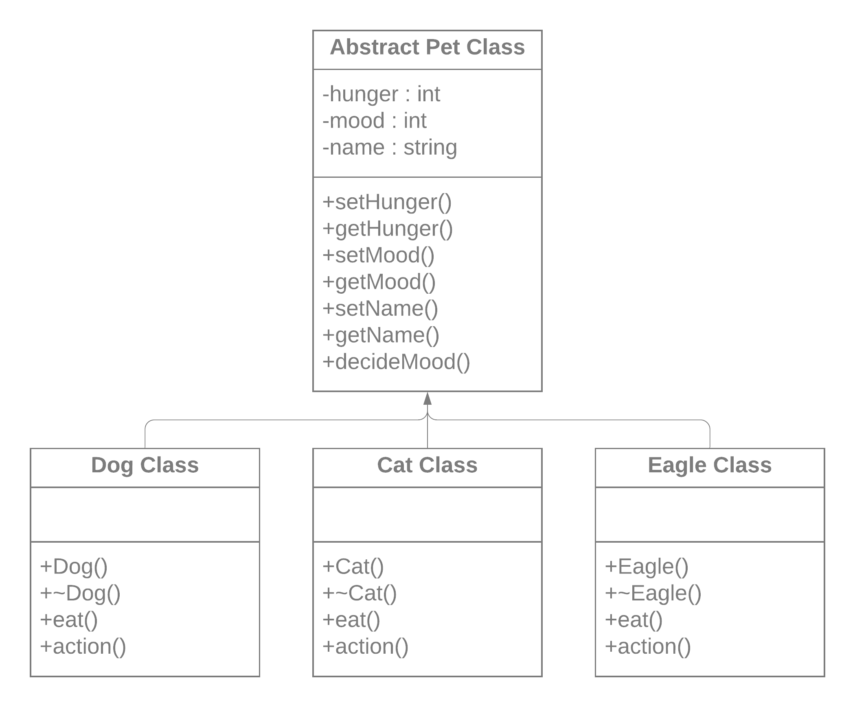
UML Class diagram

Slide 6
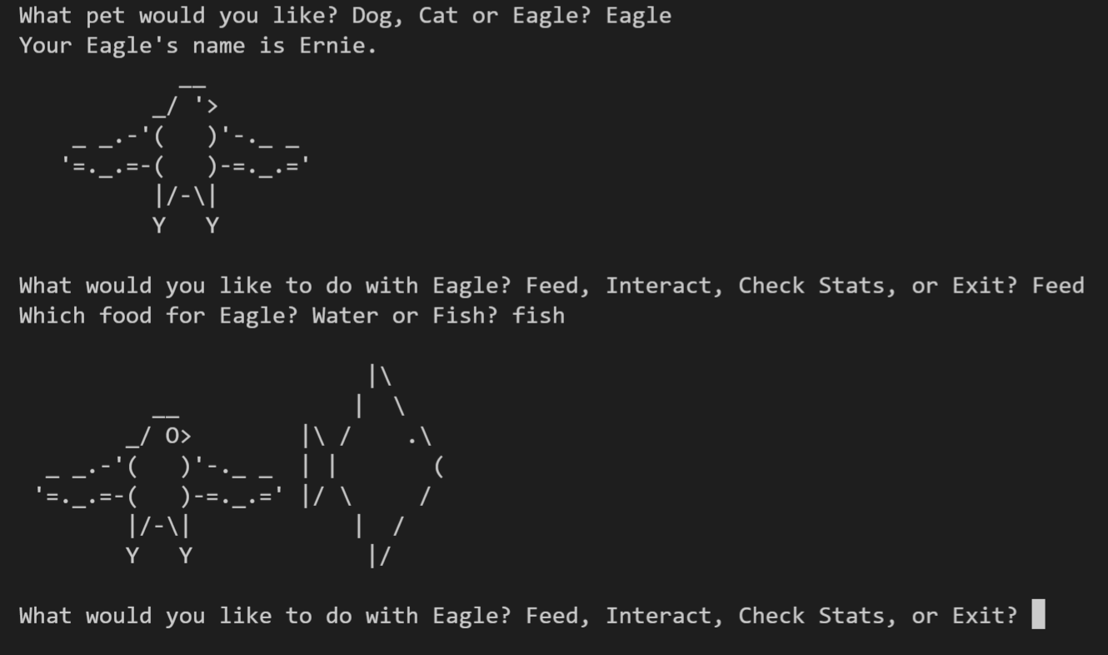
Main.cpp
Choose pet type
Choose name
Choose to feed or interact
Once done with pet, you get a pet journal
Then can choose another pet if you want

Slide 7
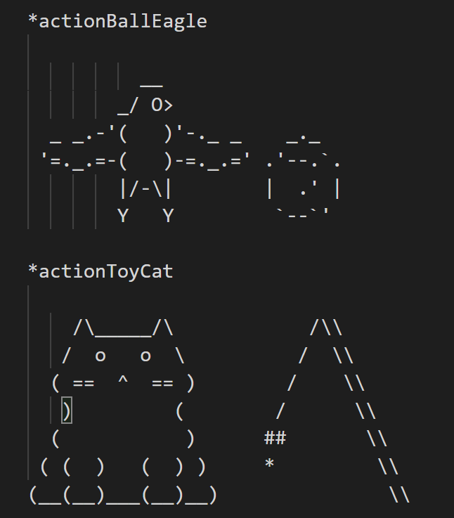
Print text art
Separate file that contains all variation of art used
Each piece is labeled with a string
A function called “retrieveArt” looks for the corresponding string to the the user’s action choice

Slide 8
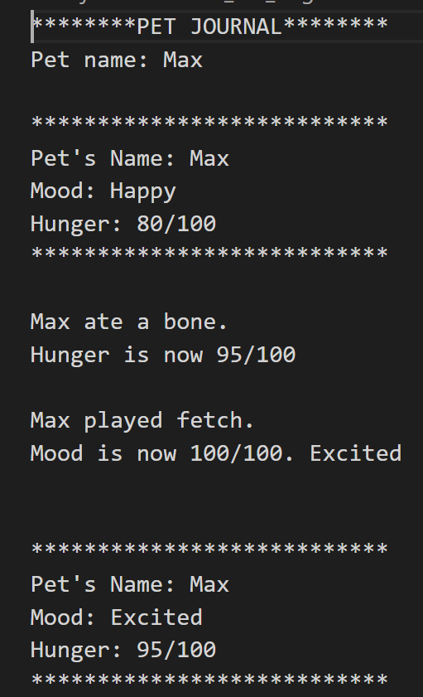
Pet journal
To remember your journey, each pet that get creates gets a pet journal
Journal contains record of all actions, as well as how they affected mood and hunger

Slide 9
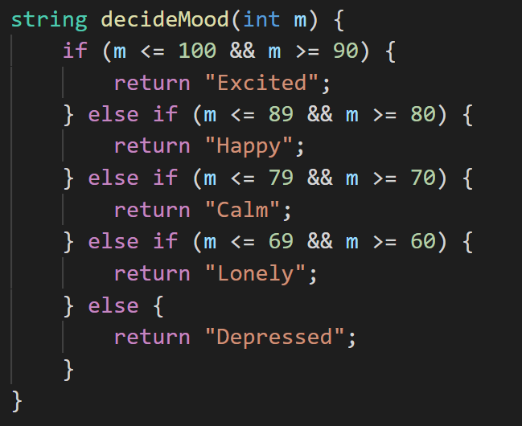
Pet Stats
Each pet has a mood and hunger
Affected by the feeding options and interaction options.
The number associated with mood, then gets translated to being excited, happy, sad,…

Slide 10
Questions?

